Slide 1
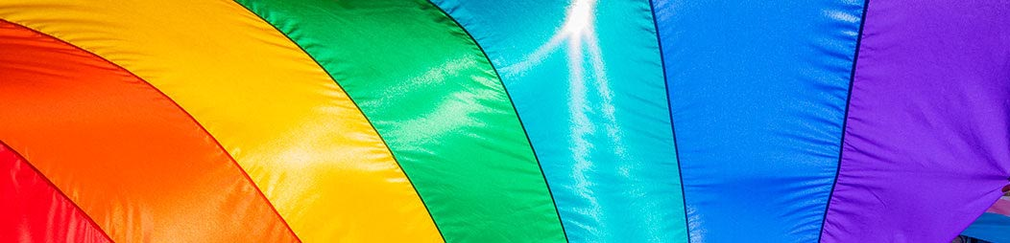
LGBTQ+ PRIDE
SRVUSD Resolution
MONTH OF JUNE
Notes:
I would like to ask the board for approval of the LGBTQ+ Pride Month Resolution

Slide 2
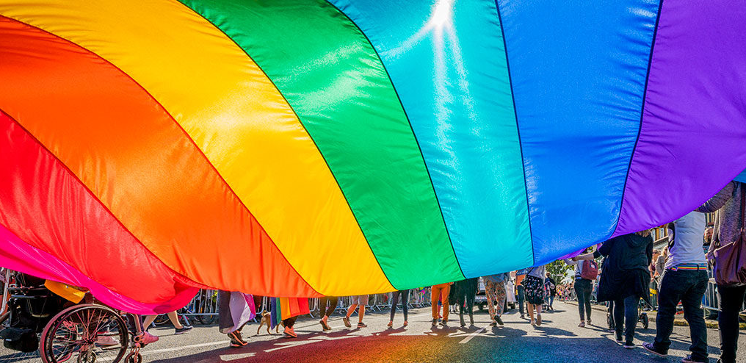
OUR STUDENTS SUCCEED WHEN WE
Celebrate DIVERSITY
Commit to EQUITY
Embrace INCLUSION
Empower BELONGING
Notes:
Our students succeed when we, as an educational community,
Celebrate diversity
Commit to equity
Embrace inclusion
Empower belonging
I believe that this resolution highlights our commitment to supporting our LGBTQ+ students, staff, and families, as we move forward with our strategic plan embracing equity, deep learning, and social/emotional wellness.

Slide 3
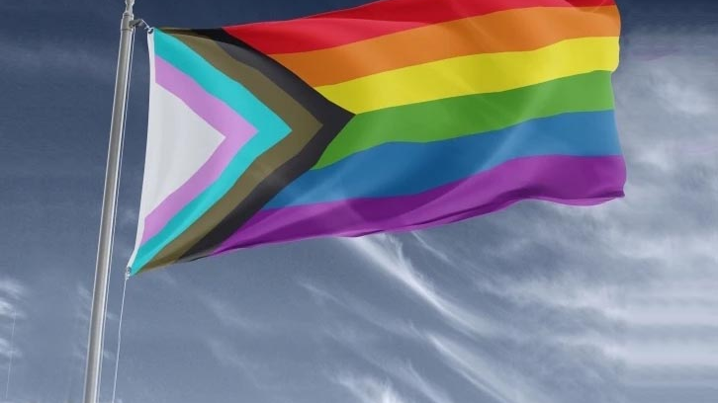
PROGRESS PRIDE FLAG
Designed by Daniel Quasar in 2018, the Progress Pride Flag adds five arrow-shaped lines to the six-colored Rainbow Flag, placing a greater emphasis on inclusion and progress. This flag includes black and brown lines to represent LGBTQ+ people of color — whose activism inspired the very first Pride — along with pink, light blue and white, which represent transgender identities.
Notes:
This resolution asks that we proudly fly the Progress Pride flag at our district office for the rest of June 2021, and at all of our district sites during the month of June starting in 2022.
Designed by Daniel Quasar in 2018, the Progress Pride Flag adds five arrow-shaped lines to the six-colored Rainbow Flag, placing a greater emphasis on inclusion and progress. This flag includes black and brown lines to represent LGBTQ+ people of color — whose activism inspired the very first Pride — along with pink, light blue and white, which represent transgender identities.

Slide 4
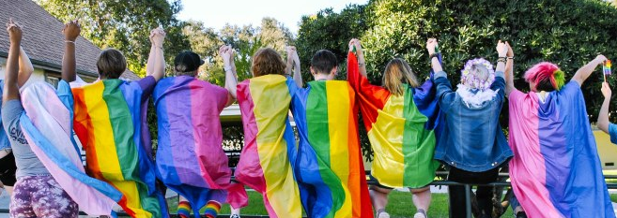
THANK YOU!
Notes:
I would like to take a moment to thank Cindy Fischer, Denise Jennison and Dr Malloy as well as PFLAG and SRVUSD Triad staff for helping to put together this resolution.
And especially to our LGBTQ+ students and allies whose strength, voice, and insight have inspired us in bringing this to the board for approval.

Slide 5

“All young people, regardless of their sexual orientation or identity, deserve a safe and supportive environment in which to achieve their full potential.”
– Harvey Milk
Notes:
As we discuss this resolution, I’d like to read this quote from Harvey Milk, “All young people, regardless of their sexual orientation or identity, deserve a safe and supportive environment in which to achieve their full potential.”
Thank you for considering this.

